Slide 1
Investigation of spinal cord processing of pain and touch in a rat model of SYNGAP1 haploinsufficiency
Katarzyna Mazur
Torsney lab
The University of Edinburgh

Slide 2
SYNGAP1 haploinsufficiency
de novo mutations in the SYNGAP1 gene → SynGAP protein production
one of most common genetic causes of neurodevelopmental disorders linked to intellectual disability (ID)
variant incidence: 6:100,000 (0.5-1% of all ID cases) (López-Rivera et al., 2020; Satterstrom et al., 2020)
moderate to severe ID
global developmental delay
epilepsy
hypotonia
sleep difficulties
autism
sensory symptoms:
high or low pain thresholds
(Vlaskamp et al., 2019)
tactile-seeking and tactile-aversive behaviours
(Michaelson et al., 2018)

Slide 3
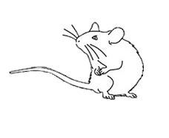
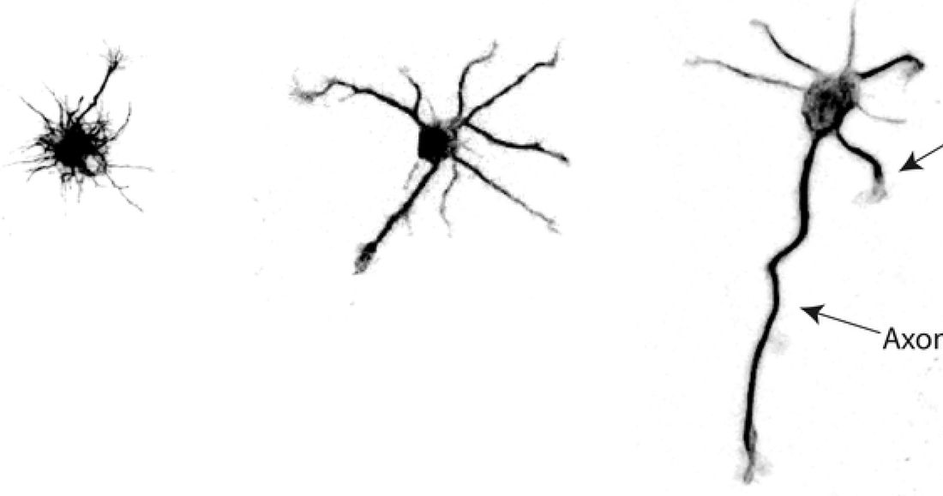
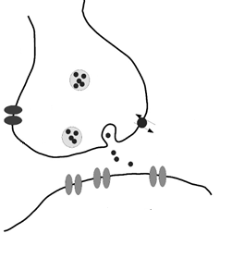
Syngap^{+/-} rat model
Syngap^{+/-} rats → 50% wild-type SynGAP protein expression
SynGAP
= Ras/Rap GTPase Activating Protein
specifically expressed in neurons
SynGAP is expressed in rat spinal cord (Kim et al., 1998)
1. neurite outgrowth
2. neuronal communication
pre-synapse
glutamate receptors
AMPAR & NMDAR
post-synapse
post-synaptic density
SynGAP
Image: Boulan et al., 2020
Image: van Putten, 2020
impact on touch and pain?

Slide 4
Syngap^{+/-} rats show unaltered pain reactivity
= mechanical pain reactivity
= thermal
pain reactivity
both sexes, adult

Slide 5
Syngap^{+/-} rats show tactile hypo-reactivity
↓ glabrous skin tactile reactivity
↓ hairy skin tactile reactivity
both sexes, adult

Slide 6
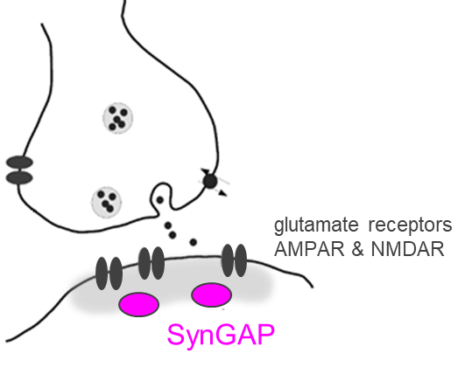
Spinal somatosensory processing undergoes postnatal development
vGlut1
SynGAP
nociceptive
superficial
nociceptive
superficial
✓
superficial
dorsal horn
spinal cord dorsal horn
spinal cord dorsal horn
immature
spinal
processing
mature
spinal
processing
tactile
postnatal
development
tactile
✓
deep
dorsal horn
deep
deep
neonate
adult
Tactile hypo-reactivity
in Syngap^{+/-} rats
anatomical
segregation?
functional
processing?

Slide 7
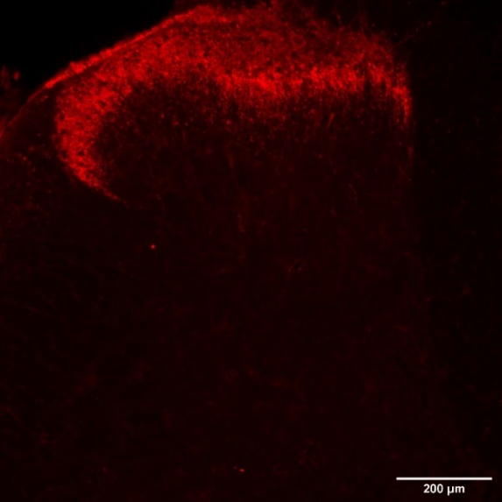
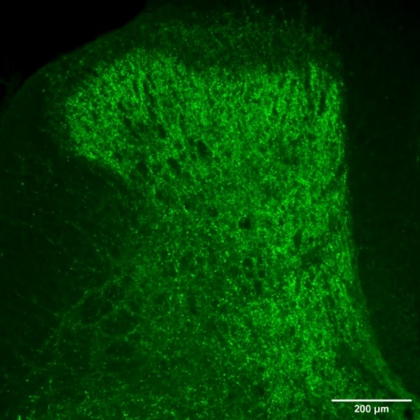
Central termination pattern of tactile and nociceptive inputs is unaltered
nociceptive
IB4 non-peptidergic C-fibres
tactile
vGlut1 tactile A-fibres

Slide 8
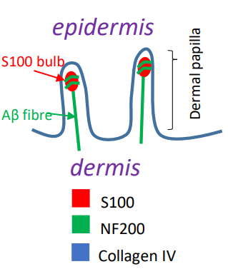
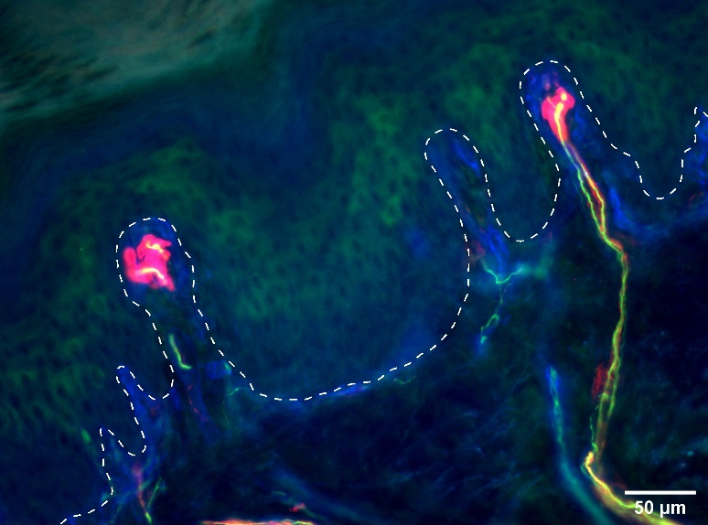
Peripheral termination pattern of tactile inputs is unaltered
S100
NF200
ColIV
unaltered gross anatomical organisation

Slide 9
Functional characterisation of Syngap^{+/-} spinal processing
nociceptive
tactile
primary afferent
electrical properties

Slide 10
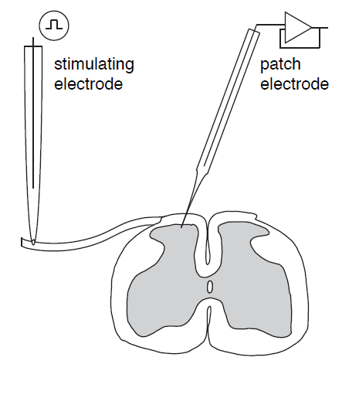
Functional characterisation of Syngap^{+/-} spinal processing
nociceptive
tactile
primary afferent
electrical properties
spinal neuron
patch recording

Slide 11
Functional characterisation of Syngap^{+/-} spinal processing
nociceptive
tactile
primary afferent
electrical properties
spinal neuron
patch recording
spinal networks

Slide 12
Electrical properties of primary afferents are unaltered
tactile
increasing electrical stimulation intensity
compound action potential
(CAP) recording
LT tactile
HT pain
~P21 isolated dorsal root
LT tactile
HT pain

Slide 13
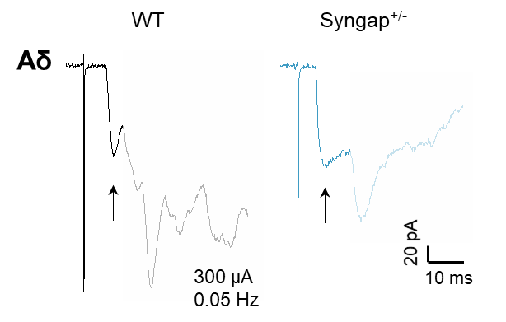
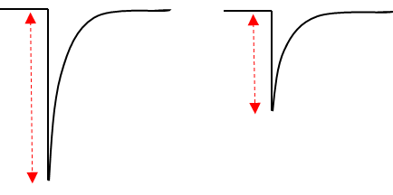
Reduced amplitude of monosynaptic inputs to tactile, but not pain, laminae
whole-cell patch clamp recording
-70mV, Cs-based low Cl⁻ internal
both sexes
WT n=8
HET n=10
monosynaptic
nociceptive
unaltered mono EPSC amplitude in superficial laminae
~P21 spinal slice
compare monosynaptic
AMPAR-mediated EPSC
input characterisation: Dickie et al., 2017

Slide 14
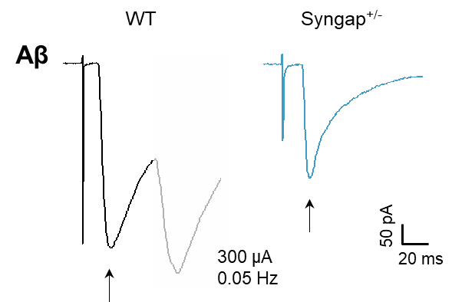
Reduced amplitude of monosynaptic inputs to tactile, but not pain, laminae
whole-cell patch clamp recording
-70mV, Cs-based low Cl⁻ internal
both sexes
WT n=8
HET n=10
monosynaptic
tactile
unaltered mono EPSC amplitude in superficial laminae
~P21 spinal slice
both sexes
WT n=5
HET n=7
compare monosynaptic
AMPAR-mediated EPSC
↓ mono EPSC amplitude in deep laminae
input characterisation: Dickie et al., 2017
potential spinal deficit in the processing of tactile, but not pain, inputs

Slide 15
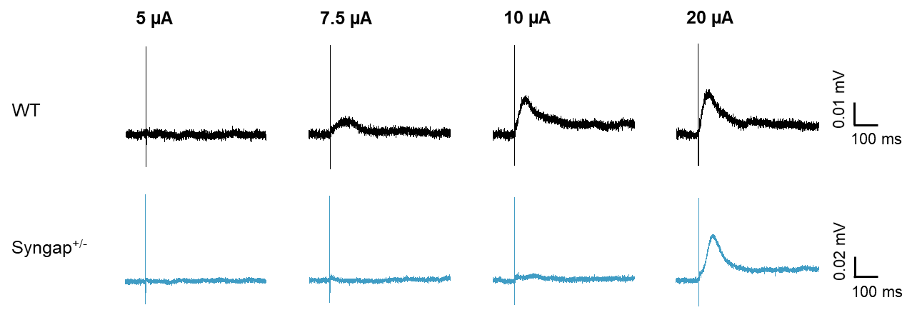
Response threshold of spinal reflex networks is increased
increasing electrical stimulation intensity
dorsal root-ventral root potential (DR-VRP) recording
↑ response threshold of spinal reflex networks
~P10 hemi-sected
spinal cord
predominantly tactile
potential spinal deficit in the processing of tactile, but not pain, inputs

Slide 16
Conclusions
Syngap^{+/-} rats are hypo-reactive to tactile but not noxious stimuli.
Central and peripheral termination patterns of primary afferents are not altered.
Electrical properties of primary afferents are not altered.
Functional studies suggest a spinal functional deficit contributes to the tactile hypo-reactivity phenotype observed in Syngap^{+/-} rats.

Slide 17
Acknowledgments
Dr Carole Torsney
Dr Ying Sze
Irene Zebochin
Lewis Scott
Hannah Sayers
Mungwun Li
Prof Peter Kind
Prof David Wyllie
Kind & Wyllie lab members

